Slide 1

Research Progress Record
Enmao Diao
Oct 01 2022

Slide 2
Overview
GAL: Gradient Assisted Learning for Decentralized Multi-Organization Collaborations
SemiFL: Semi-Supervised Federated Learning with Alternate Training
Pruning Neural Networks from a Sparsity Perspective
Semi-Supervised Federated Learning for Keyword Spotting
Decentralized Multi-Target Multi-Domain Recommender Systems
Mega Learning
Finite Neural Networks
Others

Slide 3
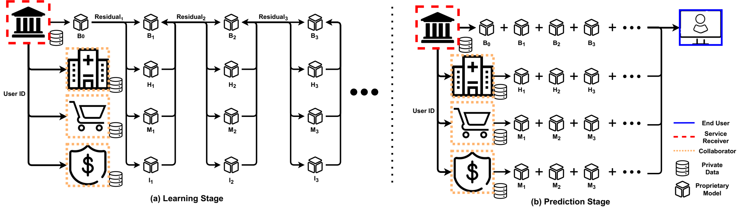
GAL: Gradient Assisted Learning for Decentralized Multi-Organization Collaborations
Submitted to NeuraIPS 2022 (Accepted)
We propose Gradient Assisted Learning (GAL), a new method for various entities to assist each other in supervised learning tasks without sharing data, models, and objective functions.

Slide 4
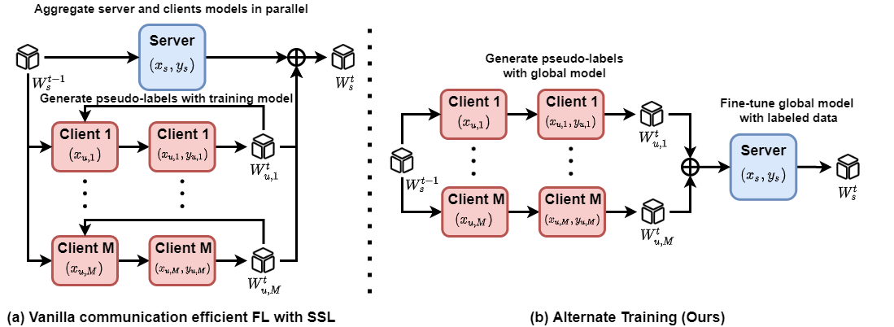
SemiFL: Semi-Supervised Federated Learning with Alternate Training
Submitted to NeuraIPS 2022 (Accepted)
We propose a new Federated Learning framework referred to as SemiFL in order to address the problem of Semi-Supervised Federated Learning (SSFL).
Extension to labeled data at clients, weak supervision, domain adaptation, etc.

Slide 5
Pruning Neural Networks from a Sparsity Perspective
With Guanghua Wang
Submitted to ICLR 2023
PQ Index for compressing using a lottery ticket framework
Benefit
Hungry initial compression
Early stopping
Random init with carefully scaled parameters
Train to maximize PQI as regularizer

Slide 6
Semi-Supervised Federated Learning for Keyword Spotting
Prepared for ICASSP 2023
Previously rejected by InterSpeech 2022
Need more novelty (finished)
Mixup background and unknown keyword
Threshold for binary opposite keyword
Amazon internal wakeword dataset
Fine tune at server to mitigate Non-IID issue

Slide 7
Decentralized Multi-Target Multi-Domain Recommender Systems
Prepared for WWW 2023
Multiple organization collaboratively learn a recommendation system
User/Item align
Explicit/Implicit feedback
AutoEncoder
Use gradient assisted learning to train vertical-split recommendation data
Cold-start problem
ML100K, ML1M, ML10M, Amazon, Douban datasets
RMSE and NDCG
Remove side information and revise paper

Slide 8
Mega Learning
With Jiawei Zhang
Prepare for CVPR 2023
Combine multiple heterogenous pre-trained classifier
Round Robin Non-IID data partition
Predetect classifier and then ensemble distillation

Slide 9
Finite Neural Networks
Input, weights and output are all on finite field
I find formal derivatives can be defined for finite field with product rule of calculus
In mathematics, the formal derivative is an operation on elements of a polynomial ring or a ring of formal power series that mimics the form of the derivative from calculus.
https://en.wikipedia.org/wiki/Formal_derivative
For example d(X^5)/dx = 5X^4 which means summation of X^4 5 times. d(f(X)/5)/dx = 1/5 d(f(X))/dx in finite field means find a value that when add 5 times equal d(f(X))/dx.
I think it is feasible to implement Finite Neural Networks with these definition.

Slide 10
Others
Hscore (Suya Wu)
Change point detection (AISTATS)
Dynamic FL (Qi Le)
Clients with different number of updates for each communication round
Mitigate Non-IID issue
Prepare for CVPR 2023
Federated Autoencoders for Personalized Federated Recommender Systems (Qi Le)
Personalized Autoencoders with independent encoder
Accepted in Asilomar 2022
Federated Client Selection against data poisoning with validation data (Xianjian Xie)
With gradient of validation dataset at server to detect poisoned clients
Prepare for CVPR 2023

Slide 11
Others
AutoAL (Xianjian Xie)
AutoML with Assisted Learning
FairAL (Yuzhe Gu)
Fair Assisted Learning for medical data
Subnetwork FL (Kamala Varma, Amazon Intern)
Once-for-all FL
Pruning
Sample heterogeneous FL (Isidoros Tzitotis, Amazon Intern)
Personalized FL with embedding (Liam Collins, Amazon Intern)
Deep Audio Signal Coding (Emily Shao, Yuzhe Gu)
Compress SDCT, STFT (mag and phase separately)
Transformer
Hierarchical residual based Vqvae

Slide 12
Others
Semi-Supervised Learning with mask (Qishen Cheng)
Reinforcement Learning for Radar (Yan Zhang)
Earthquake forecasting with Tectonics (Shang Zeng)
Graph Neural Network
Chemistry with AI (Qixuan Yu)
Time series forecasting
Quantum with AI (Omid Khosravani)
Time series denoising
Diffusive Recommender Systems with Autoencoder (Bo Peng)

Slide 13
Others
Federated Unsupervised Domain Adaptation for Target Clients
Target (unlabeled data) at clients, and Source (labeled data) at server
BoostFL: Personalized Federated Learning with Boosting
Cohort-level personalization
Boosting to flexible incorporating into existing federated learning frameworks
Assisted Learning on Time Series forecasting
Assisted Supply Chain Forecasting, Earthquake prediction, Financial Trading
Match with timestamp and geographical location (universal ID) for supply chain forecasting
Noisy alignment
Distributed Feature Selection for Assisted Learning

Slide 14
Others
Divergence of sample gradient
Saddle point
Small residual for small learning rate
Backpack library
Deep Speech Emotion Recognition
Wavelet based feature extraction
Neural Wavelet
Deep Audio Style Transfer
Lifelong Learning
Online Domain Adaptation
Online Federated Learning
Lifelong federated generative model
Lifelong learning with recalibration of BN

Slide 15
Others
Predictive gradient descent, meta-learning
Forget about learning rate. Theoretically there always exists a best gradient step at each iteration. We use learning history as our training data and predict the best gradient step. Deep Learning for optimization
Reinforcement learning to choose learning rate for faster convergence
Generator for model parameters to get fast warm-up
Mechanics-informed optimization
Deep Communication
Channel Coding
MIMO
Frequency domain or wavelet-based channel coding with Fourier operator
Federated Reinforcement Learning
Unified Supervised Learning
Semi, weak, un, self, …

Slide 16
Others
Defend adversarial attacks from intermediate layers
Hypothesis: Even though we only change very little to the input image and easily attack trained neural network. Intermediate layer features should have a very different distribution from the trained dataset. The change of result cannot happen within one layer. It is the deep nature makes classifier fragile
Design a simple Defensive BatchNorm to check statistics for adversarial detection
Recent works use MMD as data to learn detect adversarial attack
Boosting GAN
Inspired by Progressive GAN
Each scale is a network and the next network is trained from pseudo-residual
Transformer

Slide 17
Others
Efficient multi-task learning with random mask
Randomly and train mask
Fuse pretrained neural network
Fuse at certain layer with regularization
Genetic optimization of mask
Symbolic Neural Network
Prune
Finetune
Genetic optimization of symbolic choice

